Slide 1
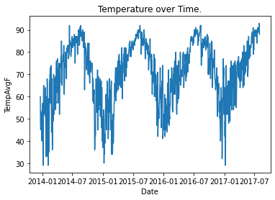
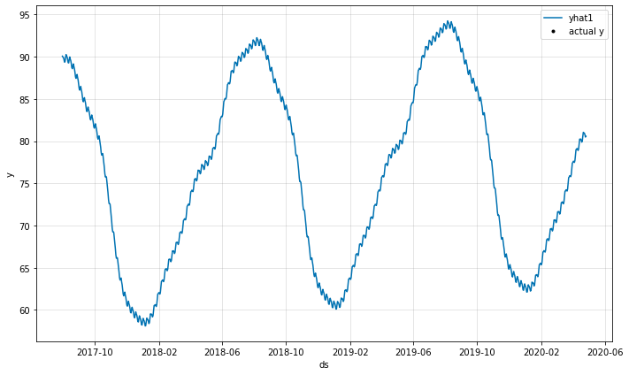
Time Series Weather Forecasting Application
Temperature over Time Graph from our Dataset
Visualizing Our Prediction

